Slide 1
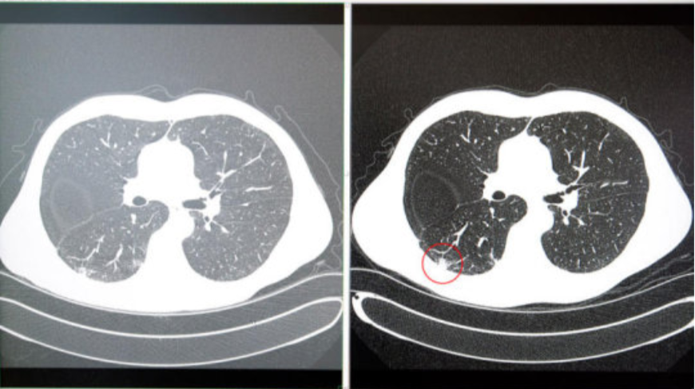
Digital Analysis of Organ CT scan for tumour detection

Slide 2
Problem Definition
Tumour detection is one of the modalities that can be used to diagnose tumours in organs. However this modality only captures the image without extracting the tumour completely. The process of extracting medical images is one of the most challenging fields nowadays. Most of the techniques used nowadays are more MRI modality compared to CT scan images because MRI images are of higher resolutions. This project describes methods to detect and extract organ tumour from patients CT scan images. Image Segmentation is used to detect the tumours . The process involves the extraction and segmentation of tumour of a patient using MATLAB software.

Slide 3
Introduction
In recent years the Image processing mechanisms are used widely in several medical areas for improving early detection and treatment stages , in which the time factor is very important to discover the disease in the patient as fast as possible, especially in various cancer tumours such as the lung cancer. Cancer tumour have been attracting the attention of medical and static communities in the recent years because of its high prevalence allied with the difficult treatment. Early detection of such tumours is very important for successful treatment. There are very few methods available to detect such canceorus tumours. One of such popular methods is using Image Segmentation.

Slide 4
Methodology
Identifying the type of noise
The noise throughout most of these images is commonly referred to as salt and pepper noise this type of noise consists of certain amounts of the pixels in the image either being black or white, the most common method of removing such noise is known to be through a medium filter “ filtering is less sensitive than linear techniques to extreme changes in pixel values, it can remove salt and pepper noise without significantly reducing the sharpness of an image”
Therefore the approach of using a medium filter within this assignment was applied Input, Grayscale and Noise removal.
Input, Grayscale and Noise removal
The problem with the initial image is the amount of noise present is very high which needs to be removed before any other processes can be applied to find the circles within the image, noise can be seen in the screenshot above and causes distortion within the image in terms of brightness and darkness “Noise which varies randomly above and below a nominal brightness value”.

Slide 5
Converting the Greyscale Image to a Binary Image
The next key step to solving the problem is to convert the current greyscale image into a binary image. The reason behind converting the image into a binary image is it allows for the better ability to detect objects within an image (circles) the reason behind this is due to the fact now only two different colours exist within the image (black, white).The image is converted into a binary image by using the im2bw function “binary_picture = im2bw(median_filtering_Image, 0.2);” This function uses the filtered image as an input and then converts the pixels within the image dependent upon the luminance level of each pixel to either the value 1 (white) or the value 0 (black).
Create a morphological structuring element (STREL)
This step involves creating a structuring element in the form of a rectangle “se1 = strel('disk', 2);”
This specific function creates a flat disk shape structure where “2” specifies the radius. This is done twice to create two separate structures which are applied to the initial binary image, creating two separate images “postOpenImage_1” and “postOpenImage_2” Once these structures have been applied the first image is applied into the subplot and shown to the user while the other is saved for later image processing to help solve to problem in later stages.

Slide 6
Inversion of the Opened Image
This step involves the inversion of the binary image which is completed by simply using a ones function, this function basically creates an array of all ones, this is implemented to the binary image “inverted = ones(size(binary_picture));” Once this is done the following is implemented “invertedImage_1 = inverted - postOpenImage_1;” This line basically takes the inverted image with the array of ones and takes the Open image from this which in turn inverts the image by swapping all previous 0 pixels to 1 pixels and 1 pixels to 0, creating an inverted image as shown above. This is completed to allow for segmentation to be completed in the following step to allow for the program to better find the circles within the image.

Slide 7
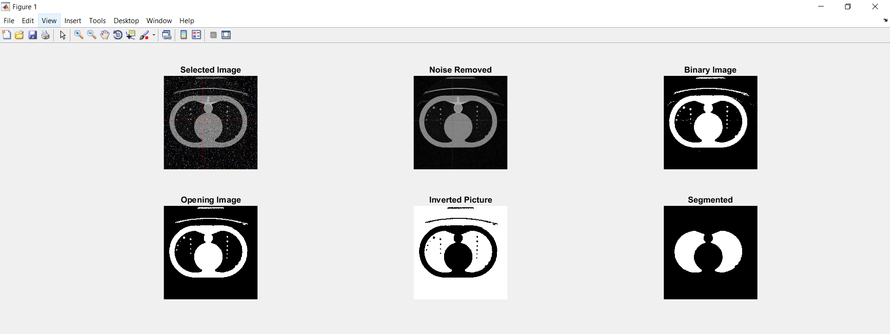
Creating an initial Contour and implementing segmentation
This step initially involves creating and specifying the initial contour “mask = zeros(size(invertedImage_1)); mask(50:end-50,50:end-50) = 1;” The mask is a binary image that specifies the initial state of the active contour, this involves the boundaries of the images regions in this case the white background and black regions outside the main part of the Image, this all allows for contour evolution to occur to allow for segmentation of the image to occur. Once the image is segmented it will produce a more clear way of finding the circles within the lung as this means the foreground and background no longer cause any issues when attempting to find the circles as seen above in the screenshot.

Slide 8
Work yet to be Done !!
Displaying and counting the number of circles in the segmented image
After the circles have been counted and found the circles need to be Segmented and then detected.
This is done by firstly creating a segmented picture “segment_pic = final_2 - final_1;” This is done by taking a picture without the circles located to a picture with the circles located, therefore leading to an image with the circles totally segmented away from the picture allowing for a precise way to find the boundaries of each circle “[B] = bwboundaries(pre_colour_pic,'holes’);“
This code basically finds all circles within the image and the boundaries and then colours each circle with a fill of green to identify they have been found as seen in the screenshot above. Therefore solving all problems indicated within the brief as the circles have been counted found and all noise has been removed.

Slide 9
References
Chan, R. H., Ho, C. W., & Nikolova, M. (2005). Salt-and-pepper noise removal by median-type noise detectors and detail-preserving regularization. IEEE Transactions on image processing, 14(10), 1479-1485.
Pal, N. R., & Pal, S. K. (1993). A review on image segmentation techniques. Pattern recognition, 26(9), 1277-1294.
Al-Kadi, O. S., & Watson, D. (2008). Texture analysis of aggressive and nonaggressive lung tumor CE CT images. IEEE transactions on biomedical engineering, 55(7), 1822-1830.
Al-Ashwal, R. H., Supriyanto, E., Rani, N. A. B., Azmira, N., Abdullah, B., Aziz, N. I., & Mahfooz, R. B. (2012). Digital processing for computed tomography images: brain tumor extraction and histogram analysis. In Math Comput Contemp Sci. 14th International Conference on Mathematical Methods and Computational Techniques in Electrical Engineering (MMACTEE13) (Vol. 26, pp. 119-28).
Gonzalez, R. C., Woods, R. E., & Eddins, S. L. (2004). Digital image processing using MATLAB (Vol. 624). Upper Saddle River, New Jersey: Pearson-Prentice-Hall.

